Slide 1
Command Prompt Heroes
The Oracle of Lost Knowledge
A Hands-On Coding Adventure

Slide 2
Welcome, Hero
You're entering a world where knowledge has been lost...
You'll learn to navigate the command line, write Python code, and automate tasks.
And you’ll do it all with a story-driven twist.

Slide 3
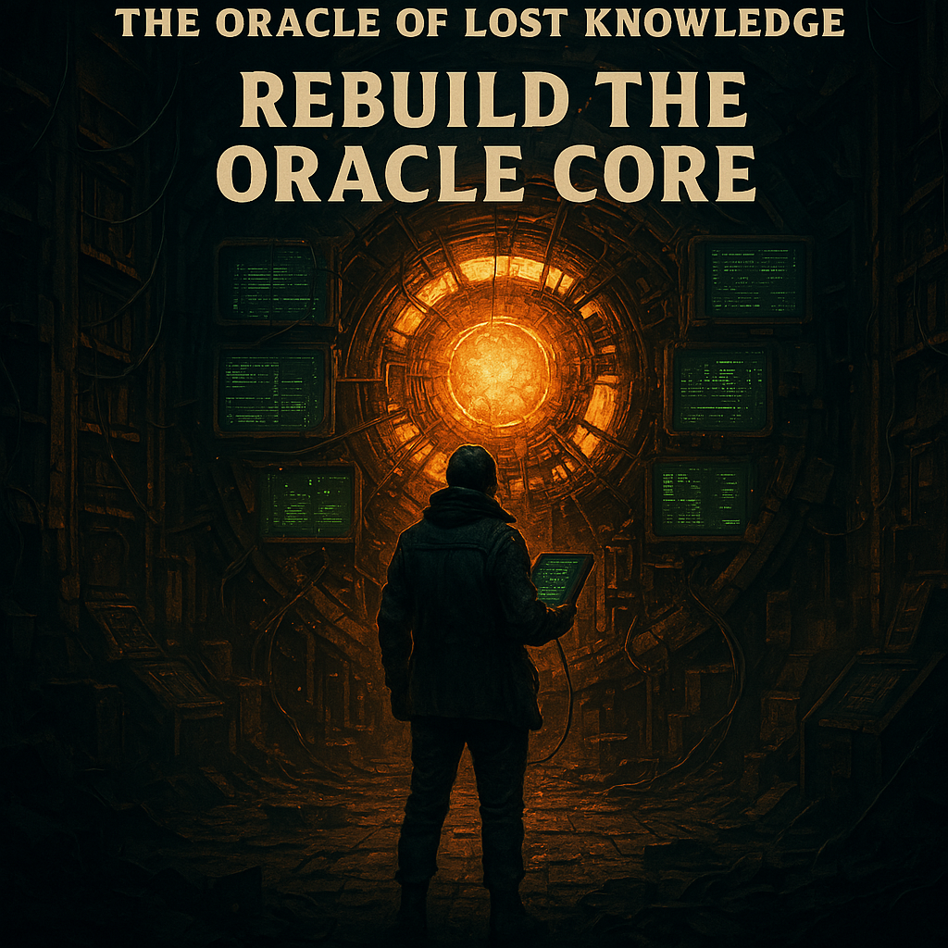
The Story Begins
The AI apocalypse has erased human technical skills.
The Oracle of Lost Knowledge is all that remains.
You are one of the few who can speak the old language: code.

Slide 4
How This Works
Self-paced labs with built-in storytelling
Each lab teaches one new skill
Helpers are here to guide you
Your mission: Unlock the Oracle

Slide 5
Game Tie-In
Play Command Line Heroes before and after
Test your terminal speed and memory
Climb the leaderboard, show your growth!

Slide 6
Lab 1: Wake the Archive
Open the terminal
Navigate files
Run your first Python script

Slide 7
Lab 2: Echoes in the Code
Learn print statements
Edit Python files
Write your first message

Slide 8
Lab 3: The Loop Protocol
Repeat yourself with for loops
Automate repetitive tasks

Slide 9
Lab 4: Decoding the Data
Use lists and `sum()`
Find structure in chaos

Slide 10
Lab 5: The Conditional Gate
Make decisions in code with `if/else`
Wrap logic in functions

Slide 11
Mini-Capstone: Automate the Lost Ledger
Clean up a messy sales file
Calculate totals with Python
Use real-world logic to solve business problems

Slide 12
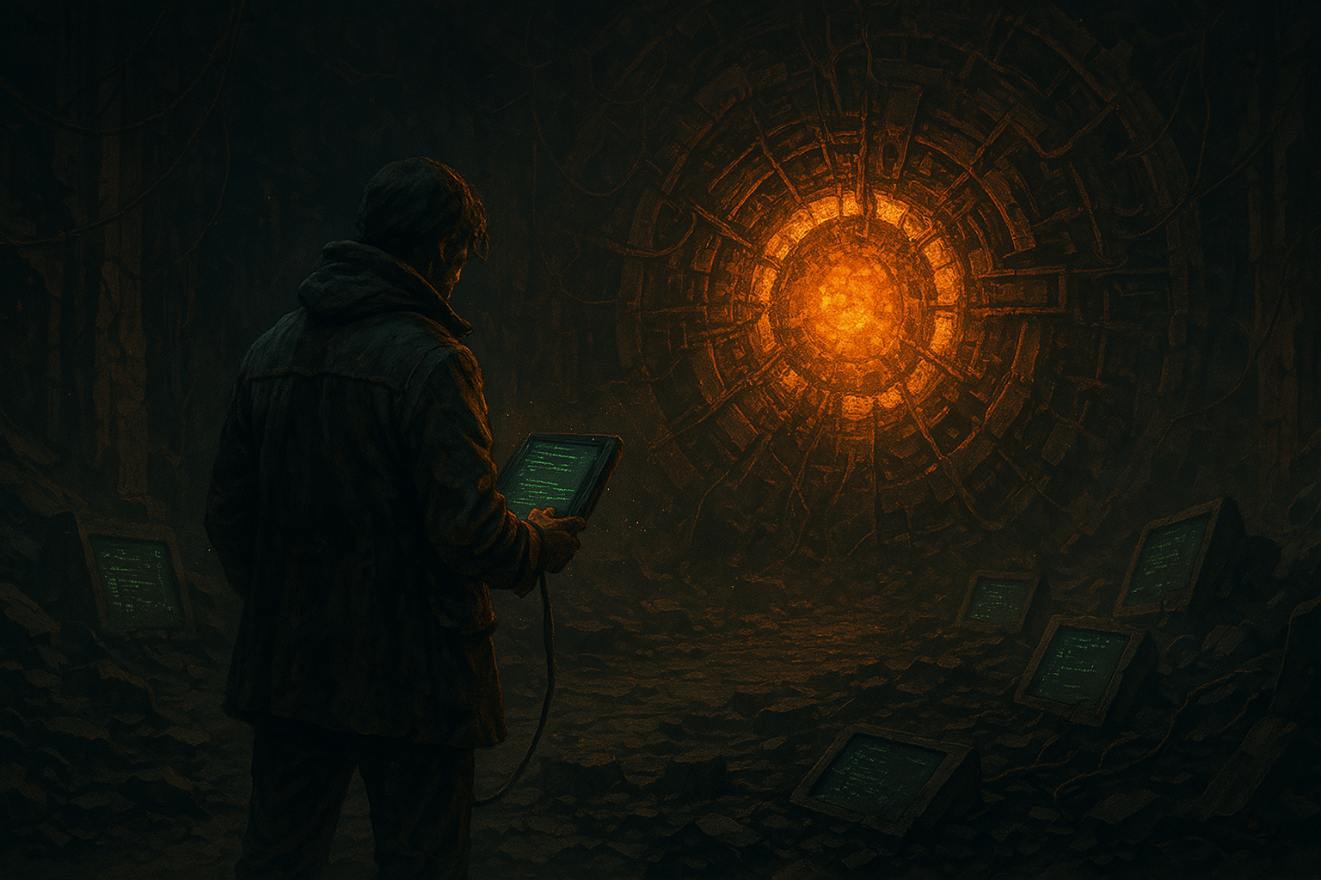
Final Capstone: Rebuild the Oracle Core
The ultimate challenge: corrupted CSV data
Fix it, process it, and extract insights
Use everything you've learned

Slide 13
Oracle Core Restored
You’ve repaired the final system. The Archive is alive again. You are a true Command Prompt Hero.

Slide 14
Thank You!
Keep learning, keep exploring
Star the repo on GitHub
You’ve done something epic—share it!

